Slide 2
ABOUT NNHAAD
National Native HIV/AIDS Awareness Day (NNHAAD) is held on the first day of Spring. This day was selected by the Native community, nationally, via survey. It was believed that this day best exemplified the ceremonies that occurred on the Spring Equinox for all Native groups (American Indian, Alaska Native, and Native Hawaiian). It was initiated in 2007 and since that time, has been successful in promoting and educating Native people about HIV and AIDS.
On this day, we encourage all Native communities to plan events to promote HIV testing and continue education of HIV and AIDS. It is also a day to honor those who are living with and affected by the disease, as well as to honor those who have passed as a result of AIDS related complications.

Slide 3
HIV/AIDS IMPACT IN NATIVE COMMUNITIES
Historically, Native communities have experienced higher rates of numerous health disparities than other racial/ethnic groups including HIV/AIDS.
American Indians, Alaska Natives and Native Hawaiians are at a greater risk for HIV infection because of the co-factors that present both health and economic challenges.
These include sexually transmitted infections, poverty, alcohol abuse, intravenous drug use, and social risk co-factors (homophobia, mistrust/distrust, etc.)

Slide 4
IMPACT COMPARED TO OTHER ETHNIC GROUPS
Native Hawaiians/Other Pacific Islanders and American Indians/Alaska Natives had the 3rd and 5th highest rate of new HIV infections, respectively. By the end of 2011, the rate was 14.2 per 100,000 persons for NHOPIs and 9.3 per 100,000 for AI/ANs.¹
Of persons who were diagnosed with HIV, AI/ANs had that shortest overall survival time, with 88% living longer than 3 years.¹
Of persons who were diagnosed with HIV, more than 38% of AI/AN and 46% of NHOPI progressed to an AIDS diagnoses in less than 12 months, the highest percentages among all racial/ethnic groups.¹
¹ Diagnoses of HIV Infection in the United States and Dependent Areas, 2011, HIV Surveillance Report, Volume 23, http://www.cdc.gov/hiv/library/reports/surveillance/2011/surveillance_Report_vol_23.html Accessed November 2013

Slide 5
NNHAAD Facts:
HIV/AIDS AMONG AMERICAN INDIANS AND ALASKA NATIVES POPULATIONS
HIV/AIDS AMONG NATIVE HAWAIIAN & OTHER PACIFIC ISLANDER POPULATIONS
Since the beginning of the epidemic through 2010, 3194 American Indians/Alaska Natives (AI/AN) have been diagnosed with HIV and 1696 with AIDS.¹
An estimated 1945 AI/ANs with AIDS have passed away.¹
By the end of 2010, there were an estimated 4890 AI/ANs living with HIV/AIDS – 3650 men, 1232 women and 9 children under 13 years old.¹
An estimated 894 Native Hawaiians/Other Pacific Islanders (NHOPI) have been diagnosed with HIV and 490 with AIDS.¹
An estimated 364 NHOPIs with HIV/AIDS have passed away.¹
By the end of 2010, there were an estimated 1384 NHOPIs living with HIV/AIDS – 1136 men, 259 women, and 4 children under 13 years old.¹
¹ Diagnoses of HIV Infection in the United States and Dependent Areas, 2011, HIV Surveillance Report, Volume 23, http://www.cdc.gov/hiv/library/reports/surveillance/2011/surveillance_Report_vol_23.html Accessed November 2013

Slide 6
Diagnosis of New HIV and AIDS Diagnoses Annually
¹ Diagnoses of HIV Infection in the United States and Dependent Areas, 2011, HIV Surveillance Report, Volume 23, http://www.cdc.gov/hiv/library/reports/surveillance/2011/surveillance_Report_vol_23.html Accessed November 2013

Slide 7
Number of Native People Living with HIV or AIDS Annually
¹ Diagnoses of HIV Infection in the United States and Dependent Areas, 2011, HIV Surveillance Report, Volume 23, http://www.cdc.gov/hiv/library/reports/surveillance/2011/surveillance_Report_vol_23.html Accessed November 2013

Slide 8
Estimated Diagnoses of HIV Infection among Adult and Adolescent American Indians/Alaska Natives by Transmission Category and Gender, United States, 2011
Note: People can belong to more than one risk category. Totals do not equal 100%
¹ Diagnoses of HIV Infection in the United States and Dependent Areas, 2011, HIV Surveillance Report, Volume 23, http://www.cdc.gov/hiv/library/reports/surveillance/2011/surveillance_Report_vol_23.html Accessed November 2013

Slide 9
Estimated Diagnoses of HIV Infection among Adult and Adolescent American Indians/Alaska Natives by Transmission Category and Gender, United States, 2011
Note: People can belong to more than one risk category. Totals do not equal 100%
¹ Diagnoses of HIV Infection in the United States and Dependent Areas, 2011, HIV Surveillance Report, Volume 23, http://www.cdc.gov/hiv/library/reports/surveillance/2011/surveillance_Report_vol_23.html Accessed November 2013

Slide 10
HIV/AIDS Among Native Children
Since 2008 there have been 2 American Indian/Alaska Native children under the age of 13 diagnosed with HIV – with no diagnoses in 2011.¹
Between 2008 and 2011, no Native child under the age of 13, has been diagnosed with AIDS.¹
Since 2008, there has not been any Native Hawaiian or Other Pacific Islander child diagnosed with HIV .¹
Between 2008 and 2011, no Native Hawaiian or Other Pacific Island child under the age of 13, has been diagnosed with AIDS.¹
¹ Diagnoses of HIV Infection in the United States and Dependent Areas, 2011, HIV Surveillance Report, Volume 23, http://www.cdc.gov/hiv/library/reports/surveillance/2011/surveillance_Report_vol_23.html Accessed November 2013

Slide 11
IHS Testing by Year
Neel, L. (personal communication, December 26, 2012). US Department of Health and Human Services, Indian Health Service, Office of Clinical and Preventative Services, Division of Clinical and Community Services, HIV/AIDS Program. Collated from internal reports.

Slide 12
IHS Testing Efforts
Neel, L. (personal communication, December 26, 2012). US Department of Health and Human Services, Indian Health Service, Office of Clinical and Preventative Services, Division of Clinical and Community Services, HIV/AIDS Program. Collated from internal reports.

Slide 13
Get on board…post your event on www.nnhaad.org/

Slide 14
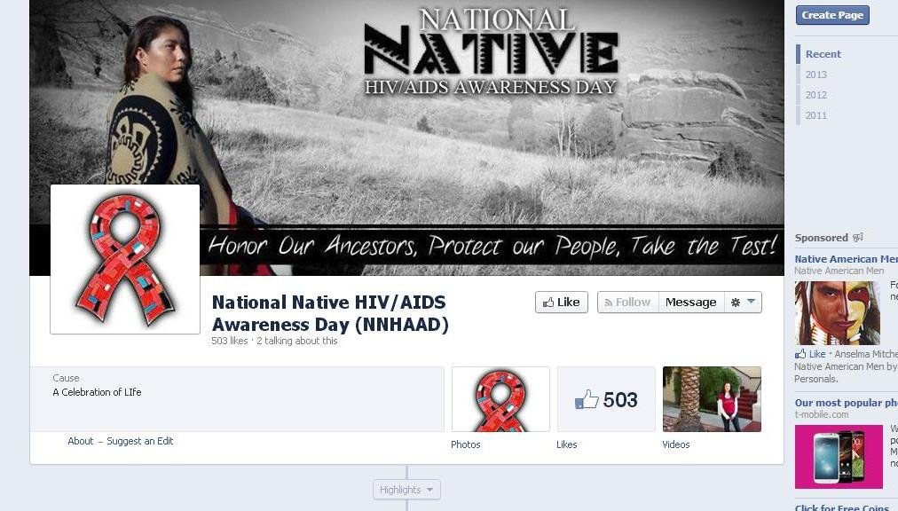
Post your event on our NNHAAD Facebook page

Slide 15
Host an NNHAAD Event
Types of Events previously held:
Health Fair
Confidential HIV Testing
Information Booths
Mini workshops
Mini Powwow
Theatre Performance
Candlelight Vigil
Sunrise Ceremony

Slide 16
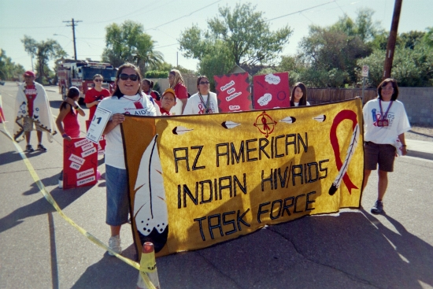
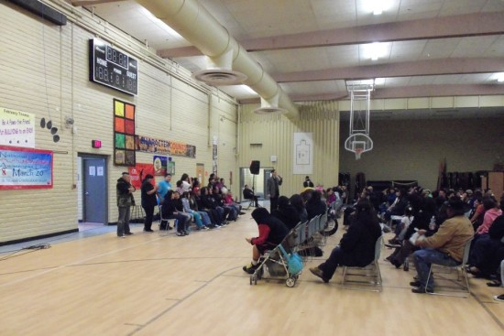
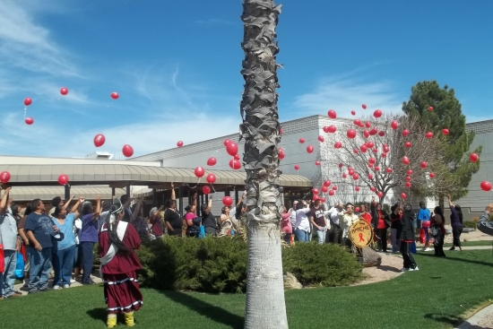
Host an NNHAAD Event

Slide 17
Other NNHAAD Ideas
Walk for awareness
Tribal/Religious ceremony
Wear Red Ribbons in your organization
Create a youth education/awareness event
Host an assembly with a guest speaker
Market the NNHAAD materials (poster, save the date card)
Post on social marketing networks

Slide 18
Other Awareness Days
February 7 National Black HIV/AIDS Awareness Day
March 10 National Women & Girls HIV/AIDS Awareness Day
May 18 HIV Vaccine Awareness Day
May 19 National Asian & Pacific Islander HIV/AIDS Awareness Day
June 8 Caribbean American HIV/AIDS Awareness Day
June 27 National HIV Testing Day
October 15 National Latino AIDS Awareness Day
December 1 World AIDS Day

Slide 19
NNHAAD Committee
Commitment to Action for 7th-Generation Awareness & Education [CA7AE]:
HIV/AIDS Prevention Project (970) 491-3954
www.happ.colostate.edu
Great Plains Tribal Chairmen’s Health Board (GPTCHB)
Northern Plains Tribal Epidemiology Center (NPTEC)
(605) 721-1922
www.gptchb.org
Inter Tribal Council of Arizona, Inc. [ITCA] (602) 258-4822
www.itcaonline.com
National Native American AIDS Prevention Center [NNAAPC]
(720) 382-2244
www.nnaapc.org

Slide 20
Additional Resources
Centers for Disease Control and Prevention (CDC): www.cdc.gov
Substance Abuse and Mental Health Service Administration (SAMHSA) - MAI: www.samhsa.gov
Find a local testing site at: http://www.hivtest.org
Get Federal information on HIV/AIDS at: www.AIDS.gov
Send a text message with your zip code to KNOWIT (566948) to find a local HIV testing center.
National HIV/AIDS Hotline: 1 (800)232-4636 1 (800)344-7432 Spanish 1 (800)243-7889 (TTY/TDD)

