Slide 1
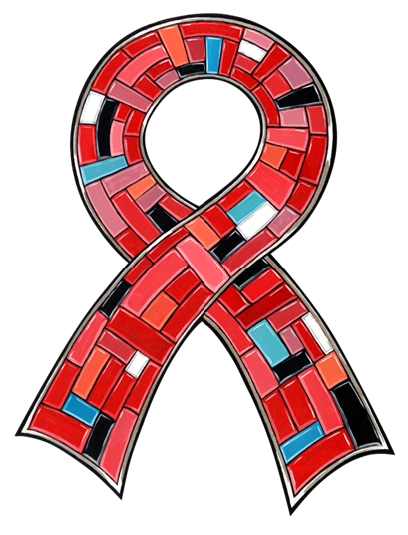
Honor Our Ancestors, Protect Our People, Take the Test!
National Native HIV/AIDS Awareness Day
(NNHAAD)
March 20, 2013

Slide 2
About NNHAAD
National Native HIV/AIDS Awareness Day (NNHAAD) is held on the first day of Spring each year.
This day was selected by the Native community, nationally, via survey. It was believed that this day best exemplified the ceremonies that occurred on the Spring Equinox for all Native groups (American Indian, Alaska Native, and Native Hawaiian).
It was initiated in 2007 and since that time, has been successful in promoting and educating Native people about HIV and AIDS.
On this day, we encourage all Native communities to plan events to promote HIV testing and continue educating on HIV/AIDS. It is also a day to honor those who are infected and affected by the disease, as well as to honor those who have passed as a result of AIDS-related complications.

Slide 3
HIV/AIDS Impact in Native Communities
Historically, Native communities have experienced higher rates of numerous health disparities than other racial/ethnic group including HIV/AIDS.
American Indians, Alaska Natives and Native Hawaiians are at a greater risk for HIV infection because of the co-factors that present both health and economic challenges.
These include sexually transmitted infections, poverty, alcohol abuse, intravenous drug use, and social risk co-factors (homophobia, mistrust/distrust of Western medical systems, etc.)

Slide 4
Impact Compared to Other Ethnic Groups
Native Hawaiians/Other Pacific Islanders and American Indians/Alaska Natives had the 3rd and 4th highest rate of new HIV infections, respectively. By the end of 2008, the rate was 22.8 per 100,000 persons for NHOPIs and 11.9 per 100,000 for AI/ANs.¹
Of persons who were diagnosed with HIV, AI/ANs had that shortest overall survival time, with only 88% living longer than 3 years.²
Of persons who were diagnosed with HIV, almost 30% progressed to an AIDS diagnoses in less than 12 months.²
¹ Centers for Disease Control and Prevention. HIV Surveillance Report, 2009; vol 21. http://www.cdc.gov/hiv/topics/surveillance/resources/reports/. Published February, 2011, Accessed June 21, 2011.
² Centers for Disease Control and Prevention. HIV Surveillance Data Report 2010; vol. 22. http://www.cdc.gov/hiv/topics/surveillance/resources/reports/. Published March 2012. Accessed December 14, 2012.

Slide 5
Facts on the Impact In Native Communities
HIV/AIDS AMONG AMERICAN INDIANS AND ALASKA NATIVES POPULATIONS
HIV/AIDS AMONG NATIVE HAWAIIAN & OTHER PACIFIC ISLANDER POPULATIONS
Since the beginning of the epidemic through 2010, 3,722 American Indians/Alaska Natives (AI/AN) have been diagnosed with AIDS.¹
An estimated 1893 AI/ANs with AIDS have passed away.¹
By the end of 2009, there were an estimated 4741 AI/ANs living with HIV/AIDS – 3478 men, 1169 women and 49 children.¹
An estimated 851 Native Hawaiians/Other Pacific Islanders (NHOPI) have been diagnosed with AIDS.¹
An estimated 363 NHOPIs with HIV/AIDS have passed away.¹
By the end of 2009, there were an estimated 1078 NHOPIs living with HIV/AIDS – 884 men, 188 women, and 7 children.¹
¹ Centers for Disease Control and Prevention. HIV Surveillance Data Report 2010; vol. 22. http://www.cdc.gov/hiv/topics/surveillance/resources/reports/. Published March 2012. Accessed December 14, 2012.

Slide 6
Number of Cases of New HIV and AIDS Diagnoses Annually
Centers for Disease Control and Prevention. HIV Surveillance Data Report 2010; vol. 22. http://www.cdc.gov/hiv/topics/surveillance/resources/reports/. Published March 2012. Accessed December 14, 2012.

Slide 7
Number of Native People Living with HIV or AIDS Annually
Centers for Disease Control and Prevention. HIV Surveillance Data Report 2010; vol. 22. http://www.cdc.gov/hiv/topics/surveillance/resources/reports/. Published March 2012. Accessed December 14, 2012.

Slide 8
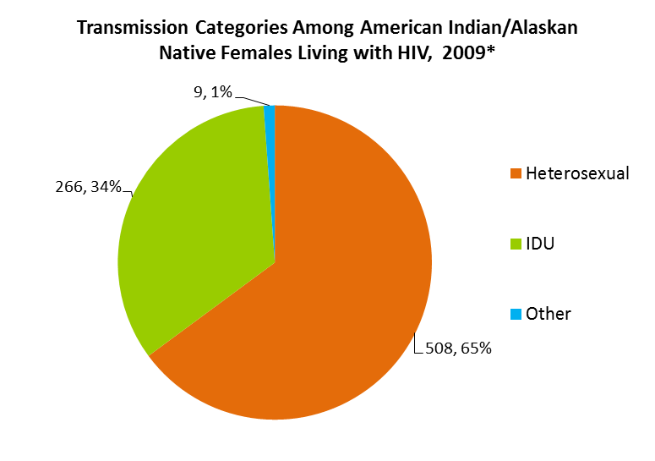
Transmission Categories among American Indians and Alaskan Natives
Centers for Disease Control and Prevention. HIV Surveillance Data Report 2010; vol. 22. http://www.cdc.gov/hiv/topics/surveillance/resources/reports/. Published March 2012. Accessed December 14, 2012.

Slide 9
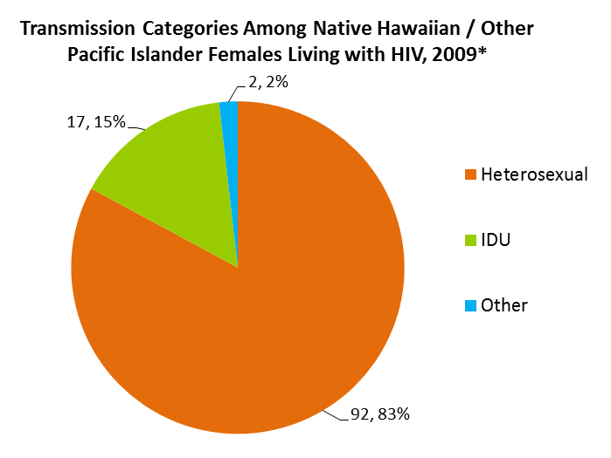
Transmission Categories among Native Hawaiians and Pacific Islanders
Centers for Disease Control and Prevention. HIV Surveillance Data Report 2010; vol. 22. http://www.cdc.gov/hiv/topics/surveillance/resources/reports/. Published March 2012. Accessed December 14, 2012.

Slide 10
HIV/AIDS Among Native Children
Since 2007 there have only been 2 American Indian/Alaska Native children under the age of 13 documented as diagnosed with HIV – with no diagnoses in 2009 or 2010.¹
Since 2007, there has not been any Native Hawaiian or Other Pacific Island child diagnosed with HIV.¹
Between 2007 and 2010, no Native child under the age of 13, has been diagnosed with AIDS.¹
It is, however, important to note that data for American Indians/Alaska Natives is under-reported.
¹ Centers for Disease Control and Prevention. HIV Surveillance Data Report 2010; vol. 22. http://www.cdc.gov/hiv/topics/surveillance/resources/reports/. Published March 2012. Accessed December 14, 2012.

Slide 11
IHS Testing by Year
Neel, L. (personal communication, December 26, 2012). US Department of Health and Human Services, Indian Health Service, Office of Clinical and Preventative Services, Division of Clinical and Community Services, HIV/AIDS Program. Collated from internal reports.

Slide 12
Indian Health Service HIV Testing Efforts
Neel, L. (personal communication, December 26, 2012). US Department of Health and Human Services, Indian Health Service, Office of Clinical and Preventative Services, Division of Clinical and Community Services, HIV/AIDS Program. Collated from internal reports.

Slide 13
Get on board…post your event on www.nnhaad.org/

Slide 14
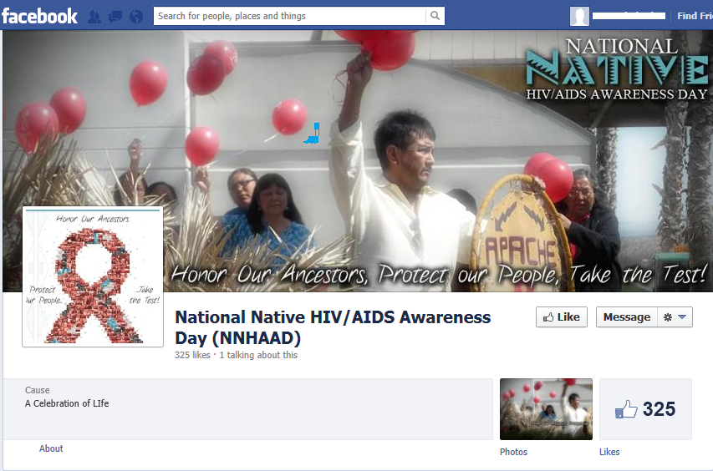
Post your event on the NNHAAD Facebook page

Slide 15
Host an Event for NNHAAD
Types of Events held during past NNHAAD’s:
Health Fair
Confidential HIV Testing
Information Booths
Mini workshops
Mini Powwow
Theatre Performance
Candlelight Vigil
Sunrise Ceremony

Slide 16
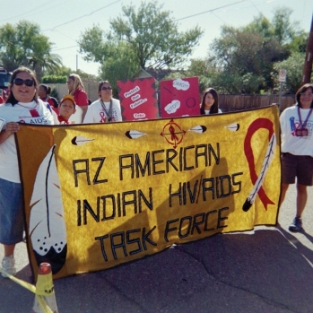
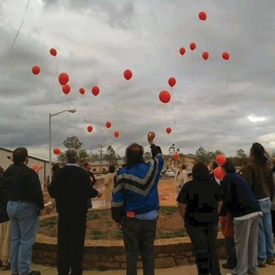
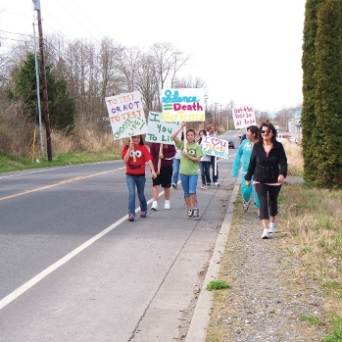
Host an NNHAAD Event

Slide 17
Other Ways to Honor NNHAAD
Walk for Awareness
Tribal/Religious Ceremony
Wear Red Ribbons in your Organization
Create a youth education/awareness event
Host an Assembly with a guest speaker
Market the NNHAAD materials (poster, save the date card)
Post on social marketing networks

Slide 18
Other Awareness Days
February 7 National Black HIV/AIDS Awareness Day
March 10 National Women & Girls HIV/AIDS Awareness Day
May 18 HIV Vaccine Awareness Day
May 19 National Asian & Pacific Islander HIV/AIDS Awareness Day
June 8 Caribbean American HIV/AIDS Awareness Day
June 27 National HIV Testing Day
October 15 National Latino AIDS Awareness Day
December 1 World AIDS Day

Slide 19
NNHAAD Committee
Asian & Pacific Islander (API) Wellness Center
(415) 292-3400
www.apiwellness.org
Commitment to Action for 7th-Generation Awareness & Education [CA7AE]:
HIV/AIDS Prevention Project (800) 642-0273
www.happ.colostate.edu
Great Plains Tribal Chairmen’s Health Board (GPTCHB)
Northern Plains Tribal Epidemiology Center (NPTEC)
(605) 721-1922
www.gptchb.org
Inter Tribal Council of Arizona, Inc. [ITCA] (602) 258-4822
www.itcaonline.com
National Native American AIDS Prevention Center [NNAAPC]
(720) 382-2244
www.nnaapc.org

Slide 20
Additional Resources
Centers for Disease Control and Prevention (CDC): www.cdc.gov
Substance Abuse and Mental Health Service Administration (SAMHSA) - MAI: www.samhsa.gov
Find a local testing site at: http://www.hivtest.org
Get Federal information on HIV/AIDS at: www.AIDS.gov
Send a text message with your zip code to KNOWIT (566948) to find a local HIV testing center.
National HIV/AIDS Hotline: 1 (800)232-4636 1 (800)344-7432 Spanish 1 (800)243-7889 (TTY/TDD)

