Slide 1
National native HIV/AIDS Awareness Day
NNHAAD
March 20th 2011

Slide 2
… A CELEBRATION OF LIFE

Slide 3
About NNHAAD
National Native HIV/AIDS Awareness Day (NNHAAD) is held on the first day of Spring. It was initiated in 2007 and has been successful in promoting and educating Native people about HIV and AIDS.
On this day, we encourage all Native communities to plan events to promote HIV testing and continue education of HIV and AIDS. It is also a day to honor those who are infected and affected by the disease, as well as to honor those who have passed as a result of AIDS related complications.

Slide 4
Impact of HIV/AIDS in Native Communities
Historically, Native Communities have experienced higher rates of numerous health disparities than any other racial/ethnic group including HIV/AIDS.
American Indians, Alaska Natives and Native Hawaiians are at a greater risk for HIV infection because of the co-factors that present both health and economic challenges.
These include sexually transmitted infections, poverty, alcohol abuse, intravenous drug use, and social co-risk factors (homophobia, mistrust/distrust, etc.)

Slide 5
IMPACT COMPARED TO OTHER ETHNIC GROUPS
Native Hawaiians/Other Pacific Islanders (NHOPI) and American Indians/Alaska Natives (AI/AN) have the 3rd and 4th highest rate of new HIV infections, respectively. ¹
In 2008, the rate was 22.8 per 100,000 persons for NHOPIs and 11.9 per 100,000 for AI/ANs, compared to 73.7 for Black/African Americans, 25.0 for Hispanic/Latinos, 8.2 for Whites, and 7.2 for Asians.¹
Of persons who were diagnosed with HIV, AI/ANs had the shortest overall survival time, with 87% living longer than 3 years.

Slide 6
NNHAAD Facts:
HIV/AIDS AMONG AMERICAN INDIANS AND ALASKA NATIVES POPULATIONS
HIV/AIDS AMONG NATIVE HAWAIIAN & OTHER PACIFIC ISLANDER POPULATIONS
Since the beginning of the epidemic through 2008, 3,629 American Indians/Alaska Natives (AI/AN) have been diagnosed with AIDS.¹
1,847 AI/ANs with HIV/AIDS have passed away.¹
In 2008, there were an estimated 2,306 AI/ANs living with HIV/AIDS – 1,650 men, 627 women and 29 children.¹
830 Native Hawaiians/Other Pacific Islanders (NHOPI) have been diagnosed with AIDS.¹
355 NHOPIs with HIV/AIDS have passed away.¹
In 2008, there were an estimated 245 NHOPIs living with HIV/AIDS – 194 men and 51 women.¹
¹ Centers for Disease Control and Prevention. HIV Surveillance Data Report 2008 (/hiv/topics/surveillance/resources/reports/); vol.20. Published June 2010. Accessed July 29, 2010.

Slide 7
Number of New HIV and AIDS Diagnoses Annually
Notes:
Centers for Disease Control and Prevention. HIV Surveillance Report, 2008 (/hiv/topics/surveillance/resources/reports/); vol. 20. Published June 2010. Accessed July 29, 2010.

Slide 8
HIV/AIDS AMONG NATIVE CHILDREN
Since 2005, there have only been 3 American Indian/Alaska Native children under the age of 13 diagnosed with HIV.¹
Since 2005, there has not been any Native Hawaiian or Other Pacific Island child diagnosed with HIV. ¹
Between 2005 and 2008, there was not been a single AIDS diagnosis among a Native child under the age of 13 years of age.
¹ Centers for Disease Control and Prevention. HIV Surveillance Data Report 2008 (/hiv/topics/surveillance/resources/reports/); vol.20. Published June 2010. Accessed July 29, 2010.

Slide 9
INCREASE IN TESTING EFFORTS
Percentage of Expecting Mothers Receiving Prenatal HIV Screenings
by IHS Annually
Notes:
L. Neel (personal communication, August 5, 2010). US Department of Health and Human Services, Indian Health Service, Office of Clinical and Preventative Services, Division of Clinical and Community Services, HIV/AIDS Program. Collated from internal reports.

Slide 10
INCREASE IN TESTING EFFORTS
Number of HIV Tests Conducted by IHS by GPRA Year
(2008 numbers inclusive of MAI funded tests)
Notes:
CDCs latest surveillance report contains data from 2008 and only from 37 states. Actual numbers may be much higher as some states excluded from the report contain large populations of AI/ANs and NHOPIs (i.e., California, Washington, Oregon, Hawaii, and Montana).

Slide 11
A Celebration of Life: Events Across the Nation

Slide 12
A Celebration of Life: Events Across the Nation
Types of Events held during past NNHAAD’s:
Health Fair
Information Booths
Mini workshops
Mini Powwow
Theatre Performance
Candlelight Vigil
Sunrise Ceremony

Slide 13
“What you Can do in your community…”
Walk for Awareness
Tribal/Religious Ceremony
Where Red Ribbons in your Organization
Create a youth education/awareness event
Host an Assembly with a guest speaker
Market the NNHAAD materials
Post on social marketing networks

Slide 14
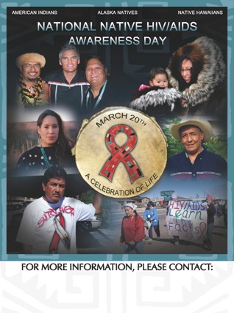
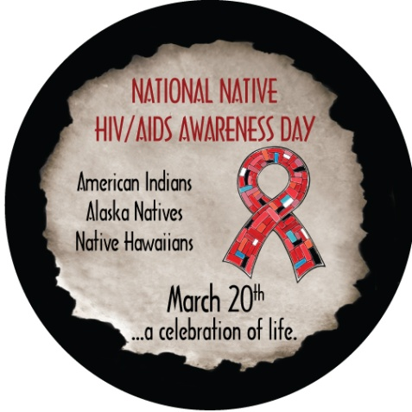
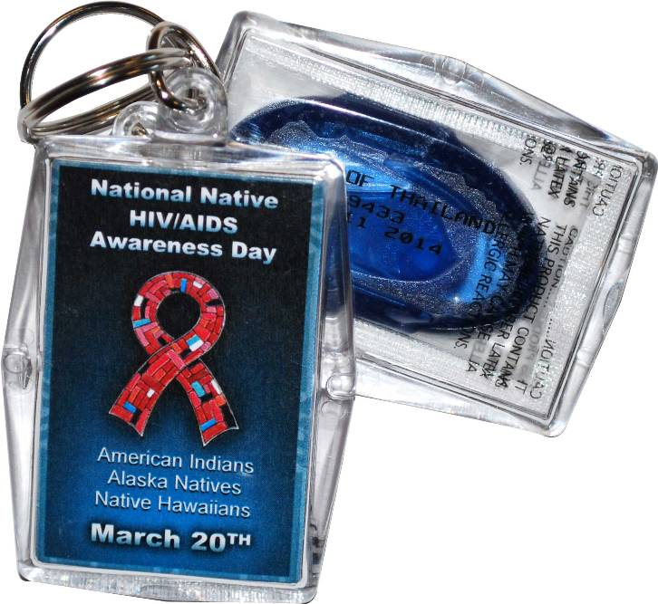
NNHAAD Products

Slide 15
NNHAAD Products

Slide 16
Other Awareness Days
February 7 National Black HIV/AIDS Awareness Day
March 10 National Women & Girls HIV/AIDS Awareness Day
May 18 HIV Vaccine Awareness Day
May 19 National Asian & Pacific Islander HIV/AIDS Awareness Day
June 8 Caribbean American HIV/AIDS Awareness Day
June 27 National HIV Testing Day
October 15 National Latino AIDS Awareness Day
December 1 World AIDS Day

Slide 17
Resources
Asian & Pacific Islander (API) Wellness Center
(415) 292-3400
www.apiwellness.org
Commitment to Action for 7th-Generation Awareness & Education [CA7AE]:
HIV/AIDS Prevention Project (800) 642-0273
www.happ.colostate.edu
Great Plains Tribal Chairmen’s Health Board (GPTCHB)
Northern Plains Tribal Epidemiology Center (NPTEC)
(605) 721-1922
www.gptchb.org
Inter Tribal Council of Arizona, Inc. [ITCA] (602) 258-4822
www.itcaonline.com
National Native American AIDS Prevention Center [NNAAPC]
(720) 382-2244
www.nnaapc.org

Slide 18
Additional Resources
Centers for Disease Control and Prevention (CDC): www.cdc.gov
Substance Abuse and Mental Health Service Administration (SAMHSA) - MAI: www.samhsa.gov
Find a local testing site at: http://www.hivtest.org
Get Federal information on HIV/AIDS at: www.AIDS.gov
Send a text message with your zip code to KNOWIT (566948) to find a local HIV testing center.
National HIV/AIDS Hotline: 1 (800)232-4636 1 (800)344-7432 Spanish 1 (800)243-7889 (TTY/TDD)

