Slide 1
National native HIV/AIDS Awareness Day
NNHAAD
March 20th 2010

Slide 3
About NNHAAD
National Native HIV/AIDS Awareness Day (NNHAAD) is held on the first day of Spring. It was initiated in 2007 and has been successful in promoting and educating Native people about HIV and AIDS.
On this day, we encourage all native communities to plan events to promote HIV testing and continue education of HIV and AIDS. It is also a day to honor those who are infected and affected by the disease, as well as to honor those who have passed as a result of AIDS related complications.

Slide 4
Impact of HIV/AIDS in Native Communities
Historically, Native Communities have experienced higher rates of numerous health disparities than any other racial/ethnic group including HIV/AIDS.
American Indians, Alaska Natives and Native Hawaiians are at a greater risk for HIV infection because of the co-factors that present both health and economic challenges.
These include Sexually Transmitted Infections, Poverty, Alcohol Abuse, Intravenous Drug Use, and Social Co-Risk Factors (Homophobia, Mistrust/Distrust, etc.)

Slide 5
Statistics: American Indians, Alaska Natives and HIV/AIDS

Slide 6
Statistics: Native Hawaiians and HIV
721 Native Hawaiians/Other Pacific Islanders (NHOPI) have been diagnosed with AIDS.
During a 5 year average, the rate of AIDS cases for Native Hawaiians/Part Hawaiians was 10.0 per 100,000 compared to Hawaii’s total rate of 7.8 per 100,000.

Slide 7
A Celebration of Life: Events Across the Nation

Slide 8
A Celebration of Life: Events Across the Nation
Types of Events held during 2009 NNHAAD:
Health Fair
Information Booths
Mini workshops
Mini Powwow
Theatre Performance
Candlelight Vigil
Sunrise Ceremony

Slide 9
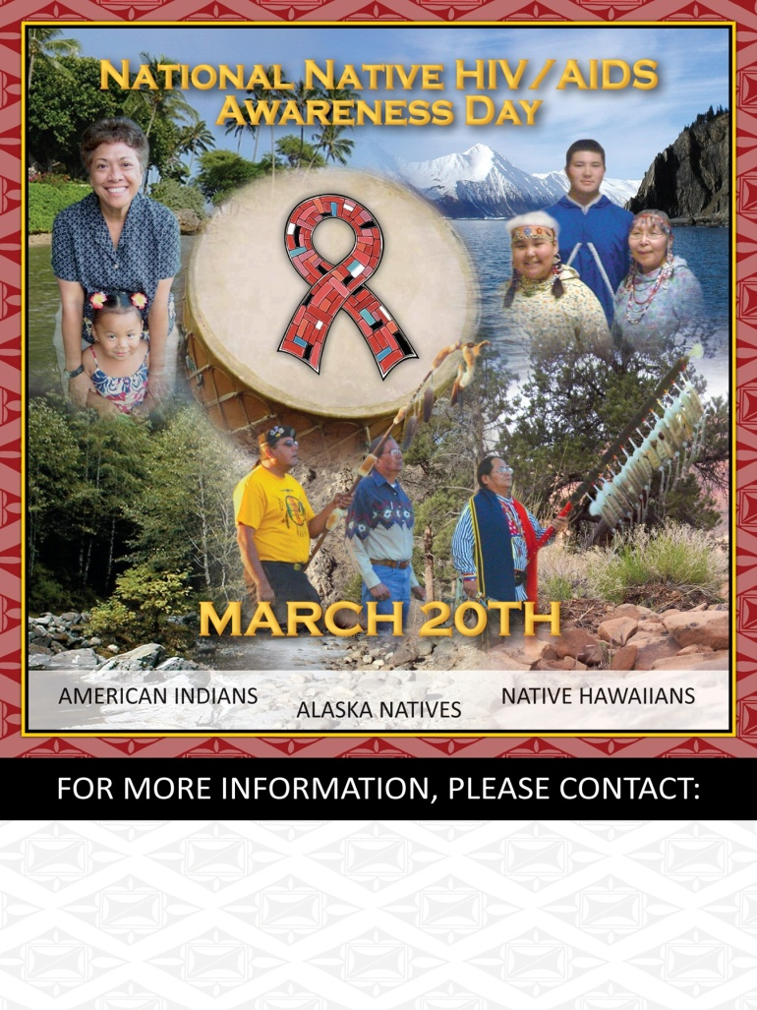
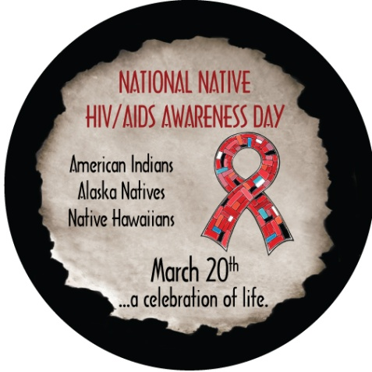
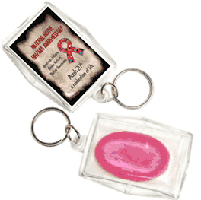
NNHAAD Products

Slide 10
Other Awareness Days
February 7 National Black HIV/AIDS Awareness Day
March 10 National Women & Girls HIV/AIDS Awareness Day
May 18 HIV Vaccine Awareness Day
May 19 National Asian & Pacific Islander HIV/AIDS Awareness Day
June 8 Caribbean American HIV/AIDS Awareness Day
June 27 National HIV Testing Day
October 15 National Latino AIDS Awareness Day
December 1 World AIDS Day

Slide 11
Resources
Commitment to Action for 7th-Generation Awareness & Education [CA7AE]:
HIV/AIDS Prevention Project (800) 642-0273
www.happ.colostate.edu
Inter Tribal Council of Arizona, Inc. [ITCA] (602) 258-4822
www.itcaonline.com
National Native American AIDS Prevention Center [NNAAPC]
(720) 382-2244
www.nnaapc.org

Slide 12
Additional Resources
Centers for Disease Control and Prevention (CDC): www.cdc.gov
Substance Abuse and Mental Health Service Administration (SAMHSA) - MAI: www.samhsa.gov
Find a local testing site at: http://www.hivtest.org
Get Federal information on HIV/AIDS at: www.AIDS.gov
Send a text message with your zip code to KNOWIT (566948)
to find a local HIV testing center.
National HIV/AIDS Hotline
1 (800)232-4636
1 (800)344-7432 Spanish
1 (800)243-7889 (TTY/TDD)

